Slide 1

3D Printing Digital Thread
03/11/2025
Sai Shreya Nunna
Computer science master student
Aymen Bahri
Electrical and Computer Engineering PhD candidate
Ahmed Ben Sidhom
Electrical and Computer Engineering PhD candidate
Advisor: Dr. Antonios Kontsos
Director, Digital Engineering Hub (DEHub)​
Henry M. Rowan Foundation Professor ​
Dept. of Mechanical Engineering​
Dept. of Electrical Engineering (courtesy)​
Materials Science & Engineering (affiliated)​
Henry M. Rowan College of Engineering (HMRCOE)

Slide 2
OUTLINE

Slide 3
OUTLINE
Artificial Intelligence and Visualization
3
Project Overview
1
4
Cloud and XR
2
Data Flow and Automation

Slide 4
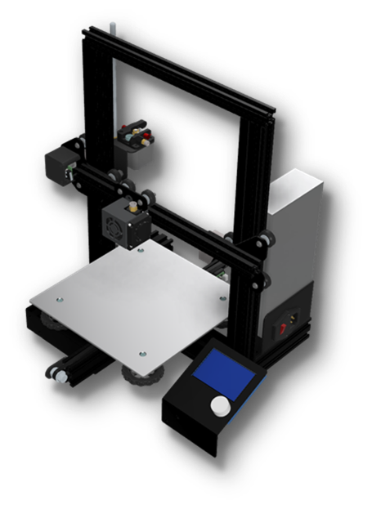
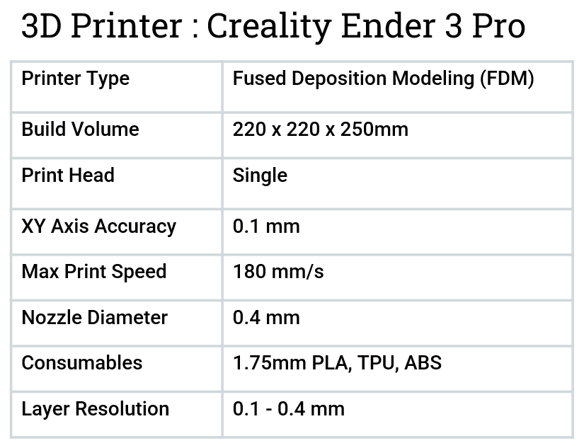
1
Project Overview
Needs to be monitored locally
STEP 1
PHYSICAL 3D PRINTER
Capable of printing geometries with .gcodes when provided in a SD card
Needs physical presence to operate

Slide 5

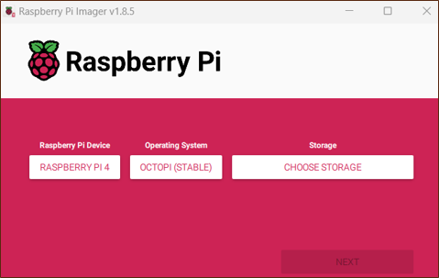
You can add multiple plugins like receiving notification of print state on your phone
STEP 2
OCTOPRINT/OCTOPI
Capable of printing geometries with .gcodes or .stl when uploaded to the controller
Enable the printer to be operated remotely
Can be installed on PC or raspberry pi
Enable the printer to be monitored remotely

Slide 6
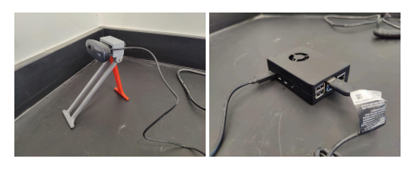
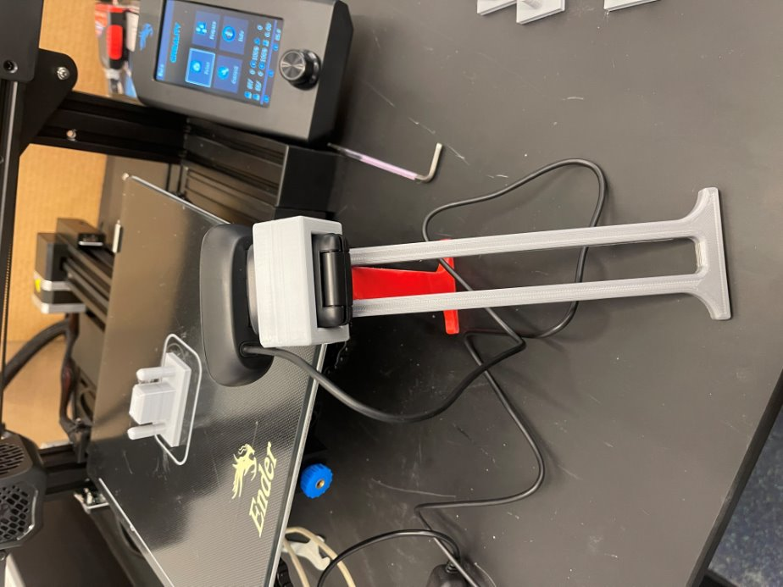
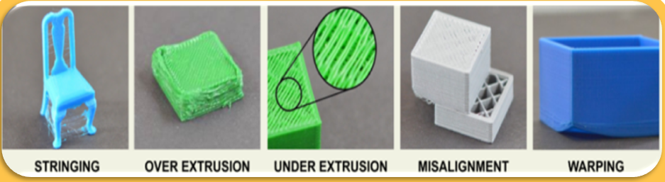
Able to collect high resolution images and save them
STEP 3
CAMERA
Allows us to detect visible defects, such as layer misalignment, surface irregularities, or unexpected material build-up
The video stream can be real time processed and fed into ML models

Slide 7
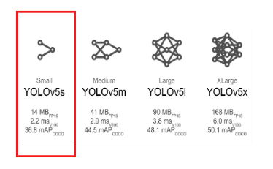
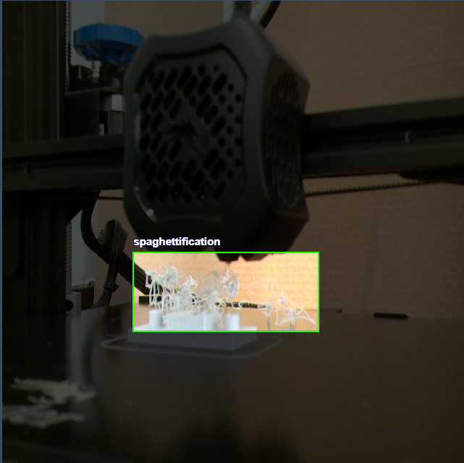
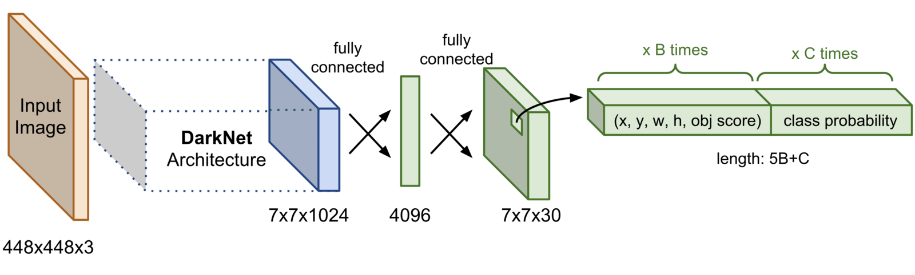
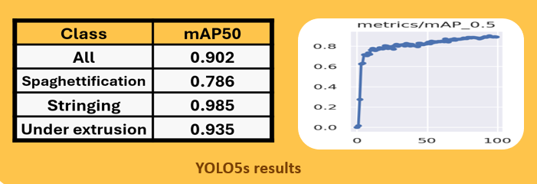
Light weight : deployable on edge
STEP 4
YOLOv5s
Light weight, fast and precise computer vision deep learning model for object detection
1 stage/network detector : fast

Slide 8
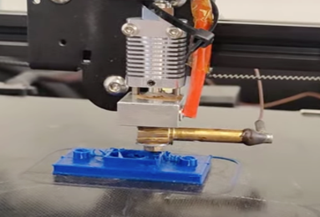
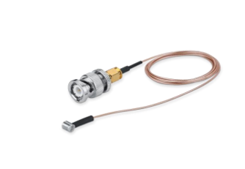
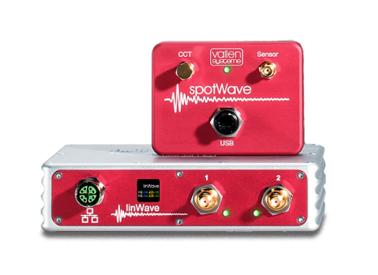
Those AE DAQs enables us to access the collected data in real time to preprocess them and feed them into ML models
STEP 5
ACOUSTIC EMISSION
Detect high-frequency sound waves generated by subtle changes within the material that might not be visible, such as micro-cracks or material stress

Slide 9
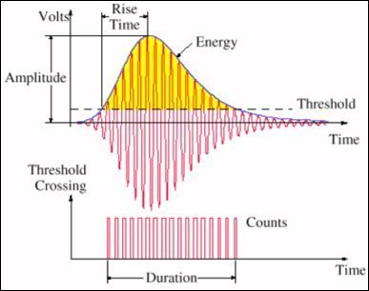
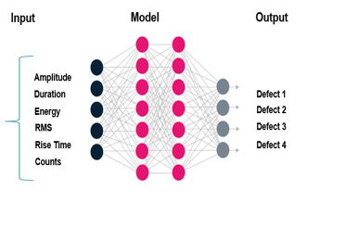
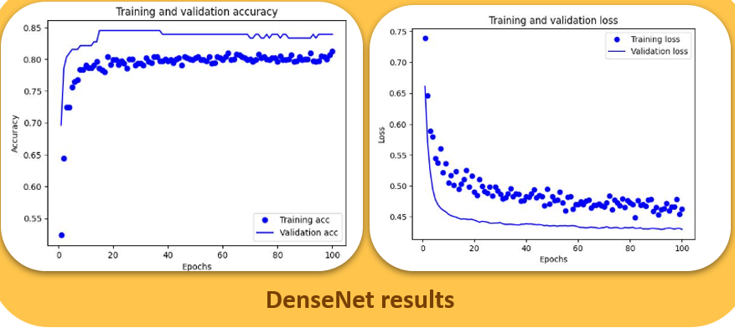
Those AE DAQs enables us to access the collected data in real time to preprocess them and feed them into ML models
STEP 6
AE CLASSIFICATION
Feature extraction techniques are applied to the acoustic data, and a dense neural network is trained to classify those defects

Slide 10
Monitor in Real-Time: Get printer status, temperatures, progress, and more
Remote Control: Start, stop, pause, and manage prints from anywhere
STEP 7
OCTOREST API
RESTful API wrapper for OctoPrint that allows you to interact with OctoPrint using simple HTTP requests.
Automate Workflows: Integrate with AI, scripts, or other tools to enhance efficiency
IoT : Connect your 3D printer to home automation or cloud-based platforms

Slide 11
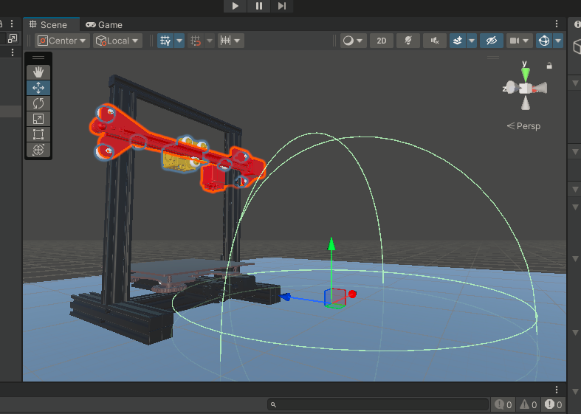

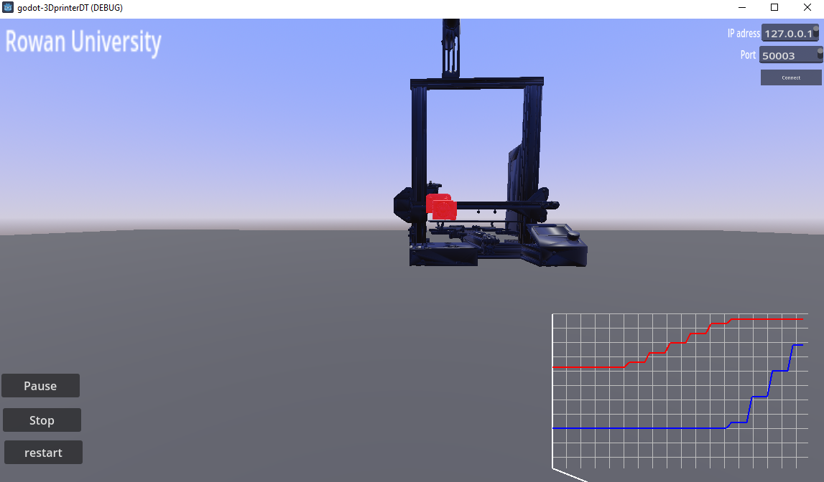
High-performance rendering with Vulkan & OpenGL
Custom Sensors & Environment Interactions
Rigid & Soft Body Physics
STEP 8
GODOT
Godot is a powerful open-source game engine that can be effectively used for building digital twins used for simulation, monitoring, and optimization
WebSockets, HTTP, MQTT for real-time data from IoT devices
Virtual Reality (VR) & Augmented Reality (AR) support
Machine Learning Integration

Slide 12

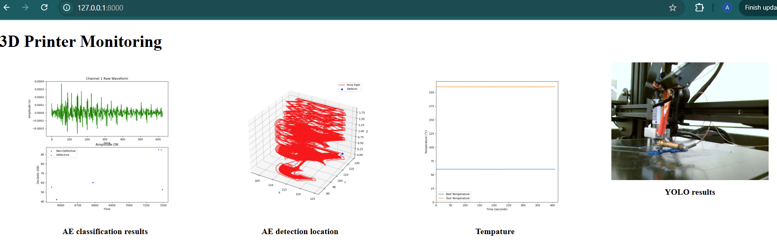
Web-Based Data Visualization: Embeds visualizations in web pages using Jinja2 templates
Backend API for Visualization Tools: Integrates with cloud services
Real-Time Data Streaming: IoT & API data integration
STEP 9
FLASK
powerful Python web framework that can be used to visualize data dynamically through web applications

Slide 13
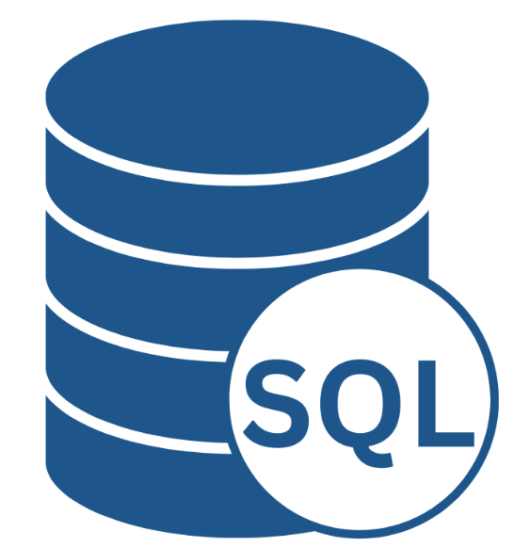
Efficient Indexing & Querying: Stores data in tables with relationships
Continuous Data Logging : Stores real-time sensor or event data
Triggers & Events : Automates actions when data changes
STEP 10
SQL
is the backbone of data storage, management, and retrieval, making it essential for monitoring systems, saving historical records, and organizing structured data efficiently.
Filtering & Searching: Queries specific data
Access Control: Manages user roles and permissions
Connects to Flask, Streamlit, Power BI for visualization

Slide 14
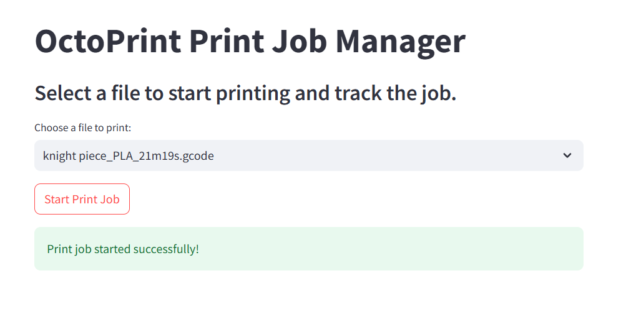
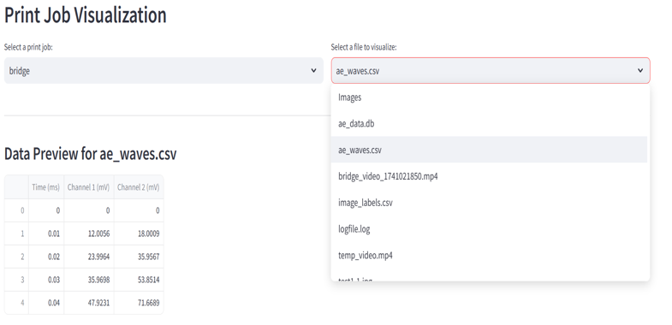

STEP 11
STREAMLIT
is a Python-based web framework that makes it easy to build interactive dashboards and visualize SQL database data with minimal code
Start a print remotely: start collecting data from sensors save the AI results in a new print job folder and create a new table in the SQL DB
Access and Query data in real time
Visualize tables and plot data

Slide 15
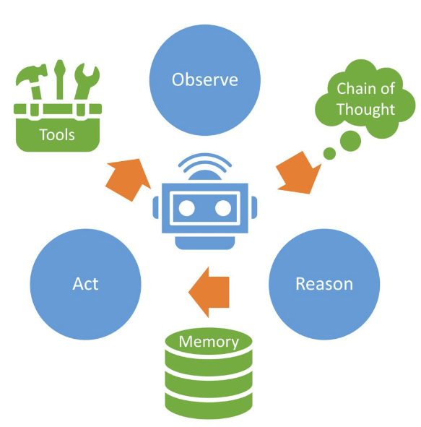
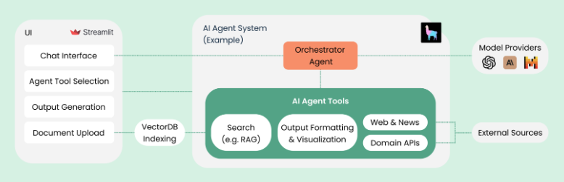
Automation & Process Control Tools:
APIs & Web Scraping
Task Scheduling (Airflow)
Robotics (ROS)
User Interaction Tools:
Speech Recognition
Text-to-Speech
Chatbots
STEP 12
AI AGENT
uses advanced language models (like GPT) to automate tasks, process information, and interact with users in natural language.
Connectivity & Integration Tools:
Databases (SQL, NoSQL)
WebSockets & APIs (Flask, FastAPI)
IoT & Edge Computing (MQTT, Node-RED)

Slide 16



Data Sharing
Amazon S3 & AWS Data Exchange
AWS Lake Formation
Amazon Redshift Data Sharing
AWS Glue
Data Collection
AWS IoT Core
Amazon Kinesis
AWS DataSync
AWS Snowball & Snowcone
STEP 13
CLOUD: AWS
AWS provides several advantages for collecting, sharing, and computing data, making it a powerful cloud platform for data-driven applications.
Data Computing & Processing
AWS Lambda
Amazon EC2
AWS Batch
Amazon SageMaker
AWS Fargate
DEHUB
Greece

Slide 17
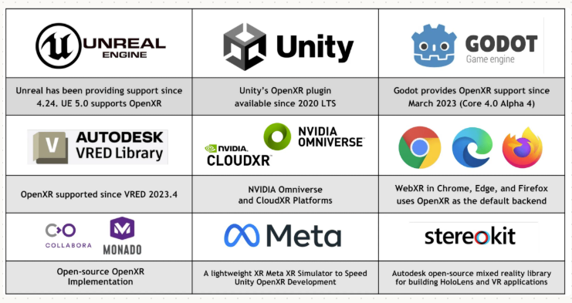
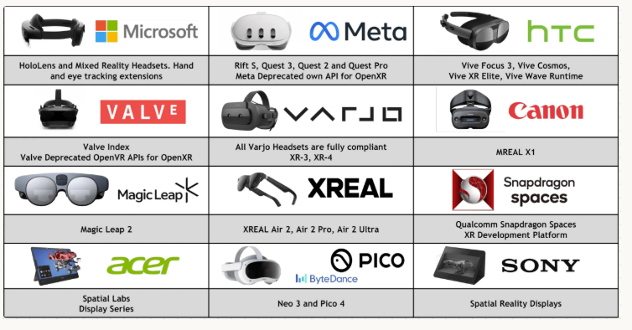

STEP 14
AR/VR: OpenXR
OpenXR is an open standard that is widely supported across various VR and AR headsets and platforms.
Game Engines & Development Tools
Unity
Unreal Engine
Godot
SteamVR
Oculus SDK
Microsoft Mixed Reality Toolkit
VR Headsets
Meta (Oculus) Quest
HTC Vive Series Valve Index
Pimax Varjo
Windows Mixed Reality Headsets
Sony PlayStation VR2
Microsoft HoloLens 2
Magic Leap 2
Lynx R-1
Operating Systems & SDKs
Windows 10/11
Linux
Android

Slide 18
2
Data Flow and Automation
Octoprint
.Gcode
HW
SW
File types
.SQL
AE DAQ
printer
Camera
.jpg
Data structures
Labeling
.log
Image classification
Object detection
Pd: Dataframe
string
.jpg: class3
.jpg: class 1
.jpg+ json/xml (coordinate BB)
Array: float
.jpg: class4
.csv/.exls
.jpg: class2
.csv/.exls+ labels
binary
Array: 3d tensors + labels
array
GODOT
.glb/usd
.keras
.pt
Array: class + probabilities
Array: class + coordinates + probabilties

Slide 19
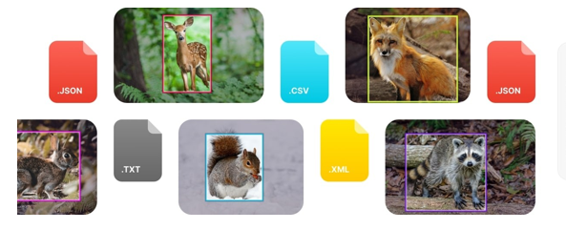
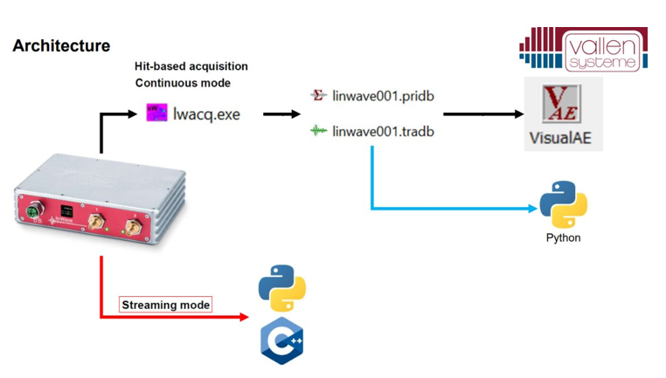
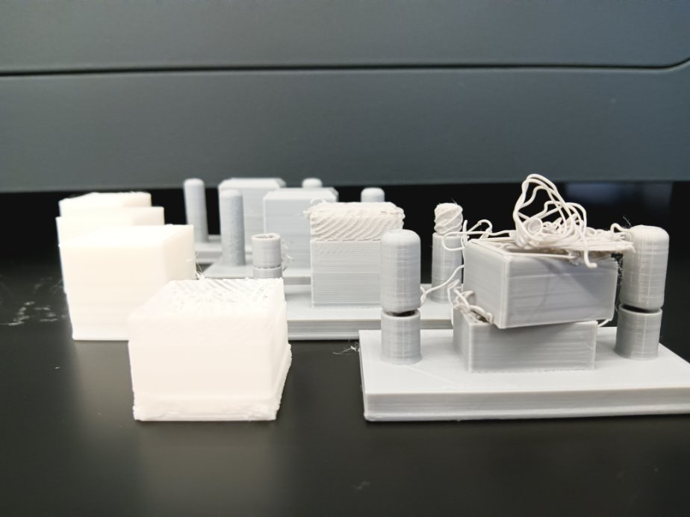
2
Data Flow and Automation
Property​ | Value​
Layer Height ​ | 0.2mm​
Wall Count ​ | 2​
Top & Bottom Layers ​ | 4​
Infill ​ | %10​
Infill Pattern​ | Cubic​
Nozzle Temperature ​ | 200.0 °C ​
Build Plate Temperature​ | 60.0 °C ​
Flow​ | 100% ​
Speed​ | 50 mm/s​
Build Plate Adhesion Type ​ | Skirt ​
Skirt Line Count​ | 3​

Slide 20
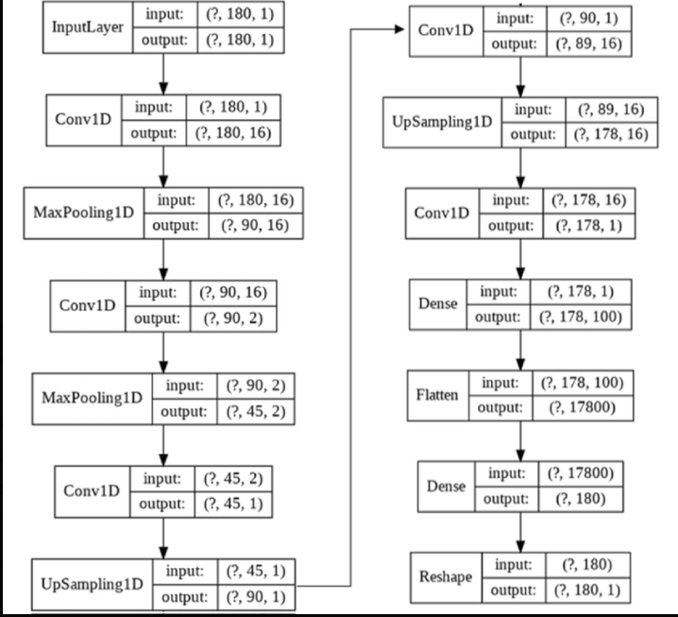
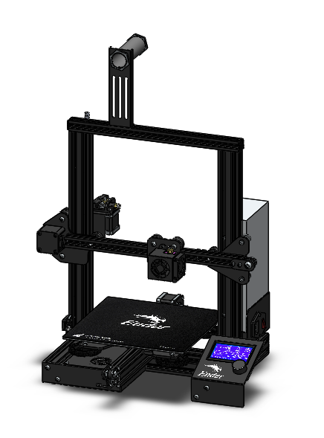
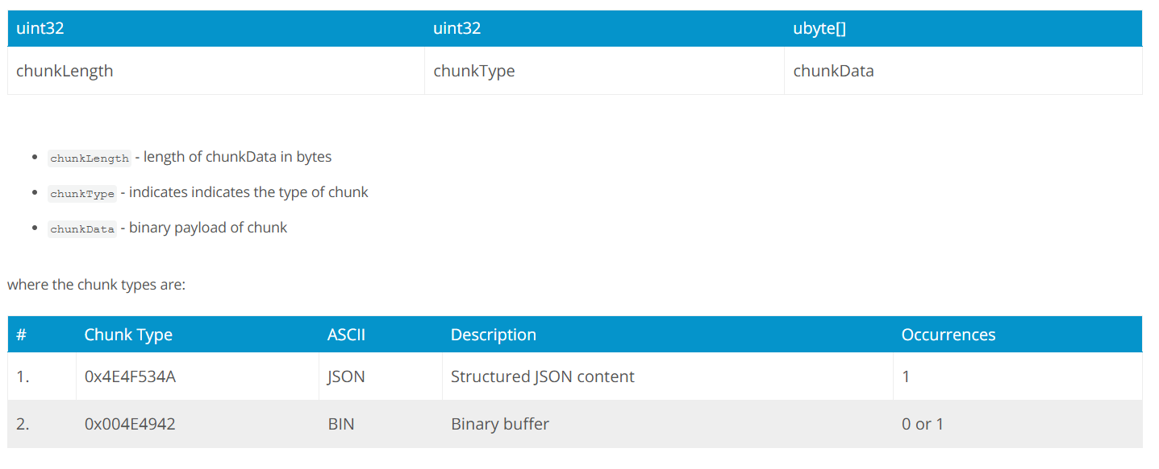
2
Data Flow and Automation

Slide 21
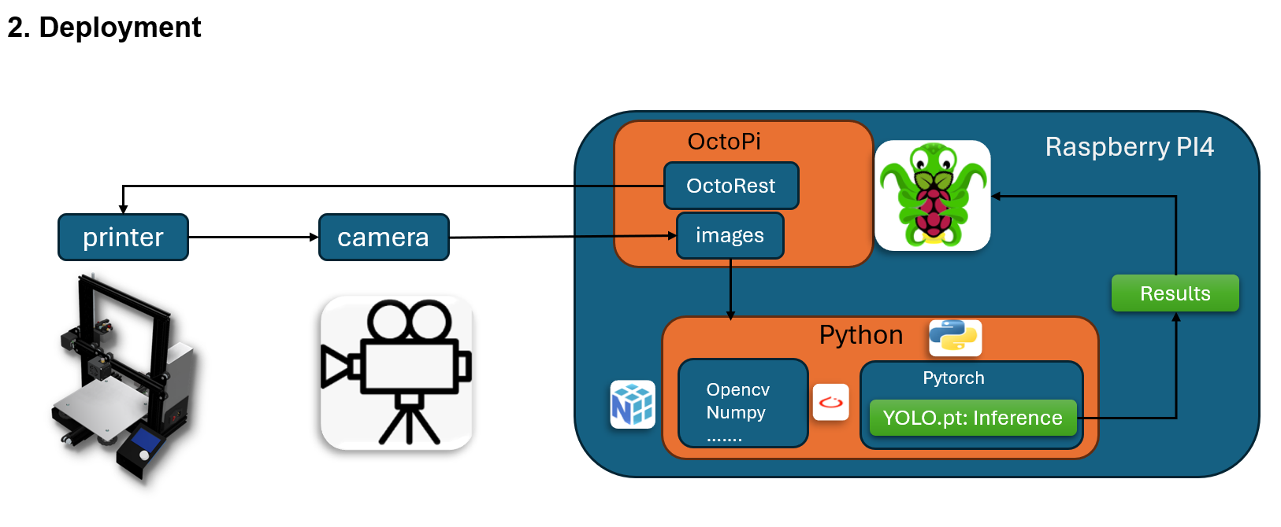
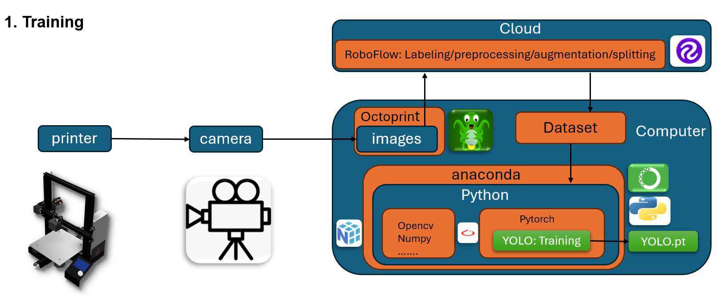
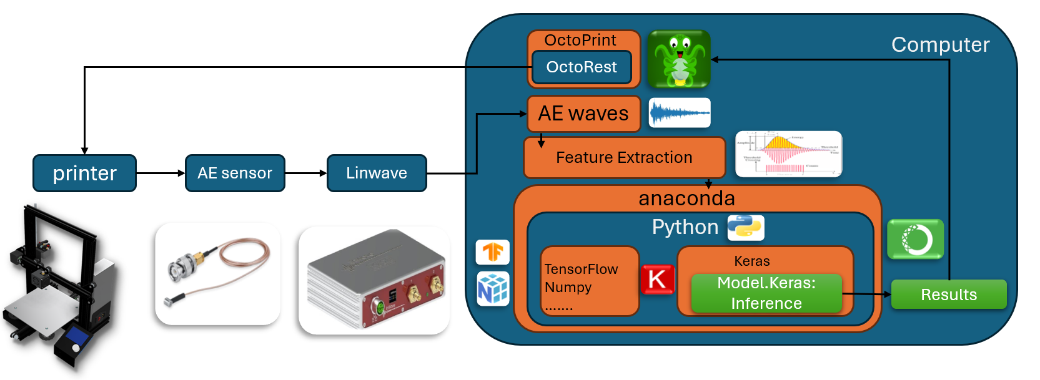
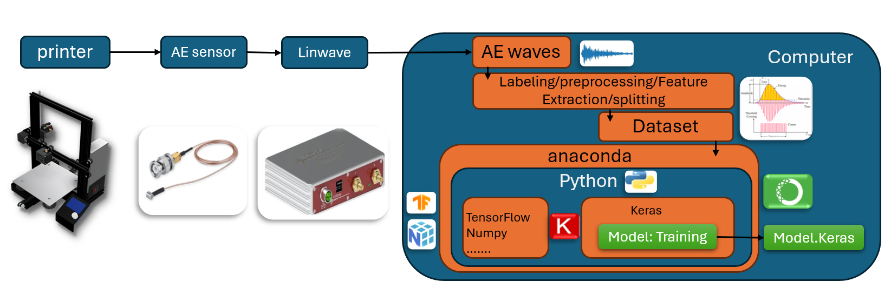
2
Data Flow and Automation
3D printing Folder
Static Folder
Dynamic Folder: print jobs
House
Bridge
Computer vision models folder
Time series models folder
Geometries folders
Printers' folder
Images folder
Images folder
.log .db
.csv .csv
.csv
.log .db
.csv .csv
.csv

Slide 22
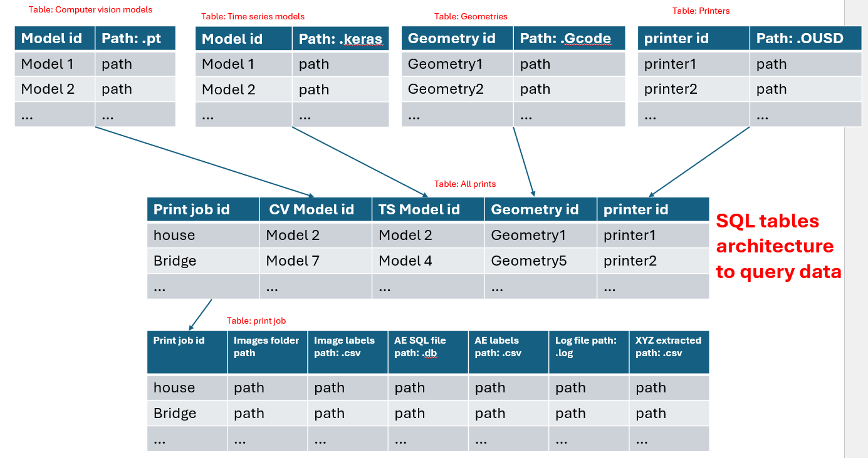
2
Data Flow and Automation
Choose CV model
New Print job folder is created
Create Job print:
Choos the name/id
Choose TS model
Choose Geometry
Choose Printer

Slide 23
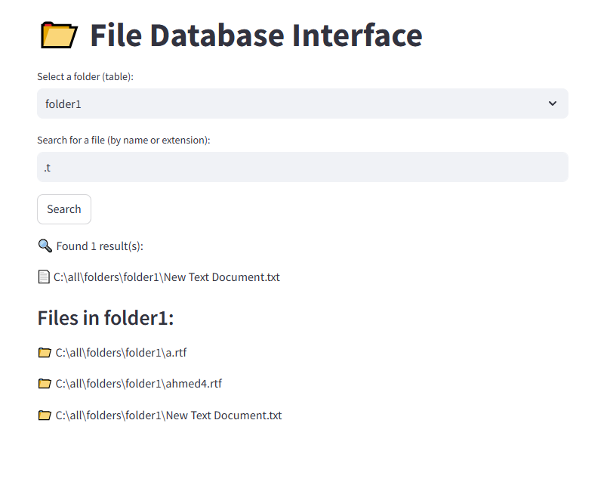
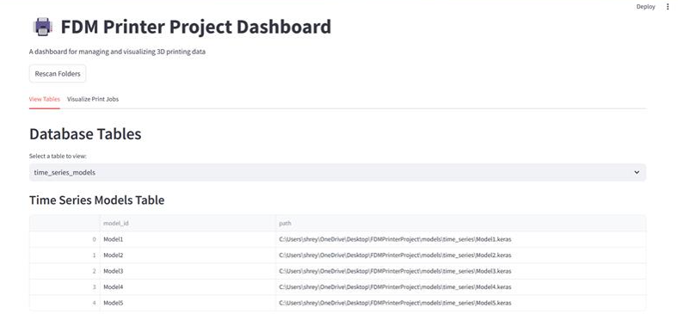
2
Data Flow and Automation

Slide 24
2
Data Flow and Automation
Connect to the printer:
Input: printer Ip address & octoprint API key; They gonna be updated automatically in the python files every connection
Connect to the SQL file:
Link the main folder to the SQL file
From static folder
Input: print job name
Input: comments
Choose the gcode: upload to octoprint
Choose the .keras: update the python file
Choose the .pt: update the python file
Choose the godot project folder: write a python file to update the path of the project folder, open godot and run the project
2. To the Dynamic folder
Save the all the print jobs parameters in a csv with name, date and time (main key ID)
Create a new folder named (name_date_time) in the Dynamic folder for each new job automatically to save the sensor data and results.
Save the raw images in ‘dynamic/cv_images/’
Save the images with bounding boxes in ‘dynamic/cv_images_results/’
Save the image labels in a ‘dynamic/cv_labels.csv’: the image id, the defect classes and the number of defects
Save the AE parameters in in ‘dynamic/AE_parameters.csv’ and AE waves, features and labels in in ‘dynamic/AE_results.csv’; write new code that don’t use the software to input the parameters or save the data (linwave or spotwave)
save the octoprint .log in ‘dynamic/raw.log’
Save the XYZ coordinates in ‘dynamic/geometry.csv’
Save the comments in ‘dynamic/comments.text’
Run the python files

Slide 25
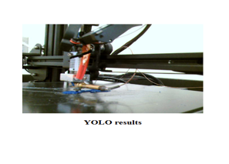
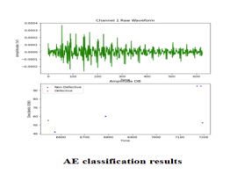
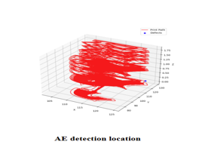
3
Artificial Intelligence and Visualization
By integrating real-time visualizations of our computer vision and time series models with the evolving geometry of the print, we can monitor and analyze the printing process effectively, gaining insights into potential defect triggers

Slide 26
3
Artificial Intelligence and Visualization
Our object detection model overlays real-time bounding boxes and confidence scores on the printing process, highlighting potential defects as they emerge. By integrating these visualizations with time-series data and geometric analysis, we can track defect formation, assess its severity, and predict failure patterns, ensuring proactive intervention.

Slide 27
3
Artificial Intelligence and Visualization
Our time series model classifies waveform patterns from sensor data and visualizes them in real-time using distinct colors. Each color represents a different classification, allowing for quick identification of irregularities in the printing process

Slide 28
3
Artificial Intelligence and Visualization
When a defect is detected, its waveform is mapped to the corresponding spatial location within the built geometry, allowing for precise defect localization. This enables real-time visualization of defect formation, aiding in root cause analysis and proactive intervention

Slide 29
3
Artificial Intelligence and Visualization
Trained models
Log files
Sensor data
APIs;
Octoprint
Gmail
Telgram
…
Database
Code/control system
Access saved data (read/write)
LLM
Modify codes or parameters
Send commands and feedback directly or through API
Interact with prompts
And provide notifications
Keep track of previous prompts
Actuators
Robot arm
…
Local/cloud user interface
Interactions and prompts history

Slide 30
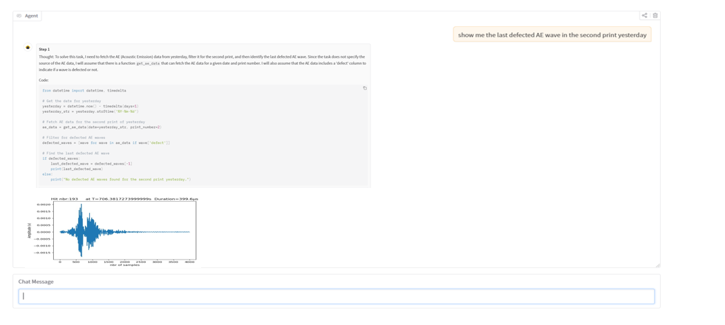
3
Artificial Intelligence and Visualization

Slide 31
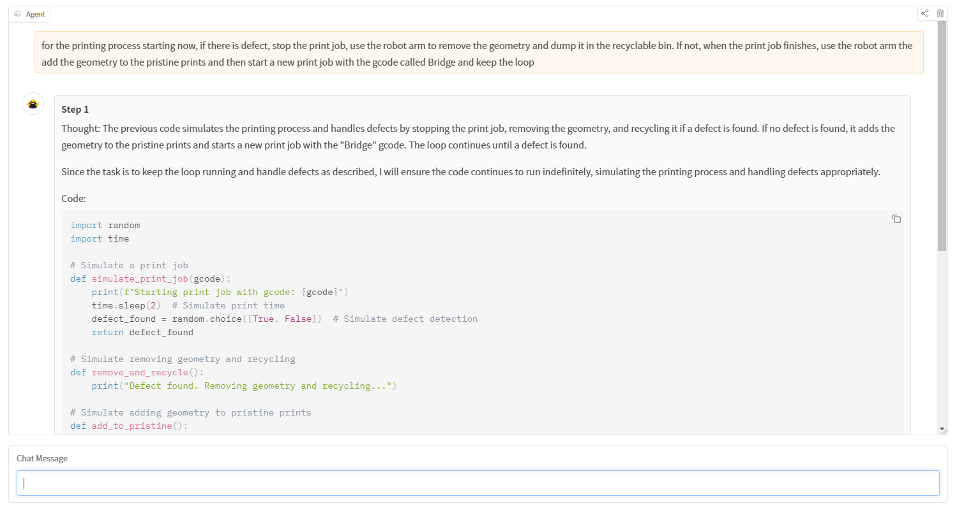
3
Artificial Intelligence and Visualization

Slide 32

4
Cloud and XR
Sensor data
AI models
Python files
SSL certificate
EC2 compute node
XYZ coordinates I
images
AE signals

Slide 33
4
Cloud and XR
results
Python files
SSL certificate
EC2 compute node
Sensor data
AI models
Python files
Edge/local compute node
XYZ coordinates
images
AE signals

Slide 34
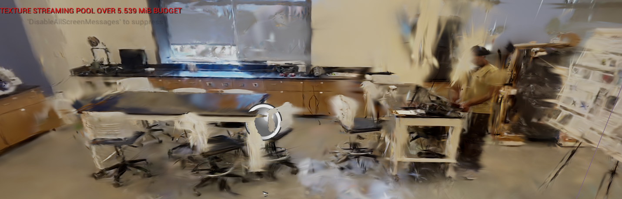
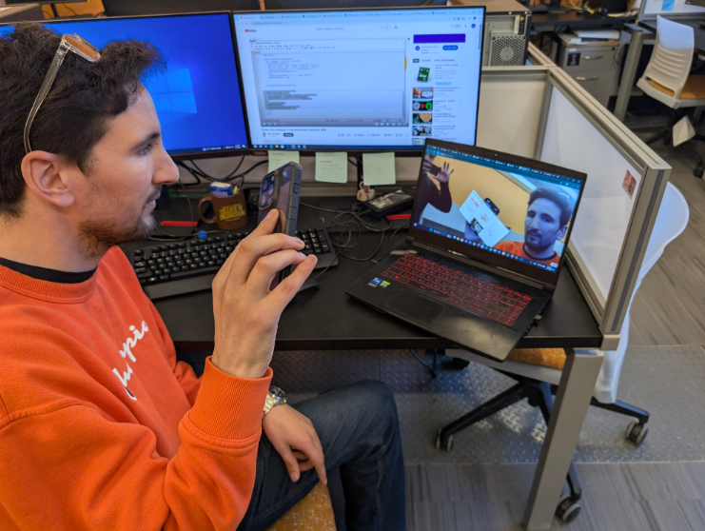
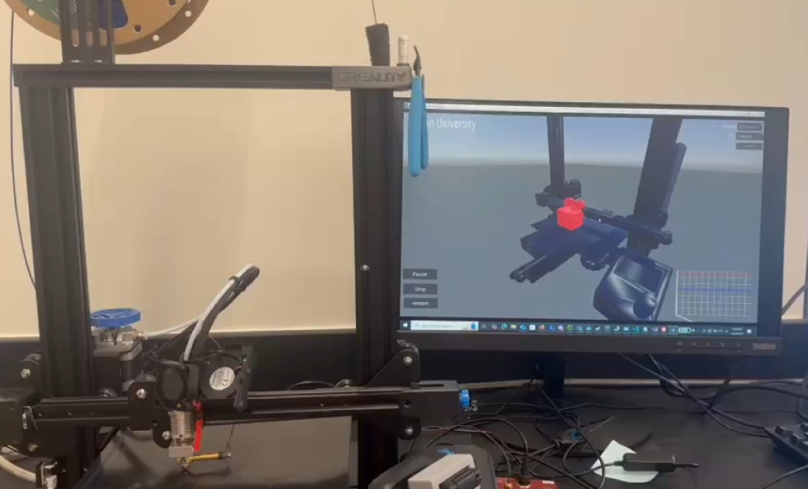
4
Cloud and XR

Slide 35
Thank you for your attention!
Questions?
kontsos@rowan.edu
bensid28@students.rowan.edu
bahria76@rowan.edu
nunnas57@students.rowan.edu

